Slide 1
15213/15513/18213 Final Exam Review Recitation

Slide 2
Topics
Virtual Memory
I/O Redirection
Threading
Processes and Signals
Deadlock
Note: other topics may appear on the final exam!

Slide 3
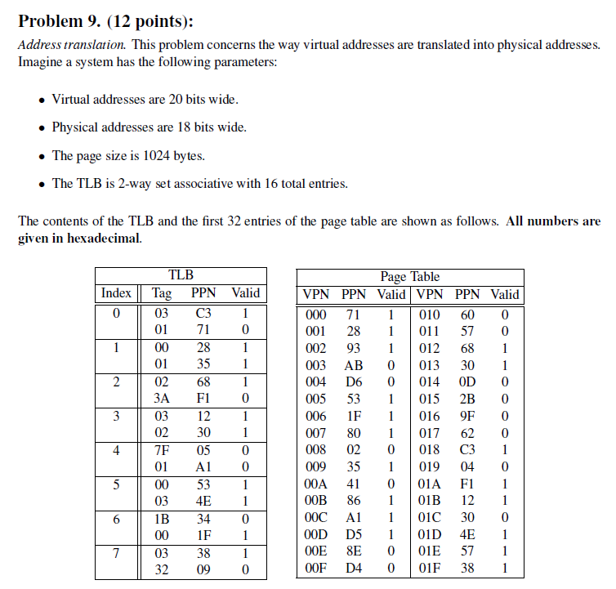
Virtual Memory
Final Exam Fall 2012

Slide 4
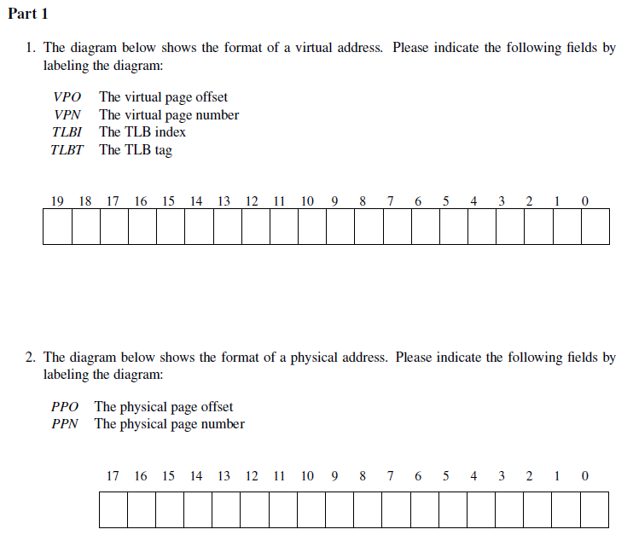

Slide 5
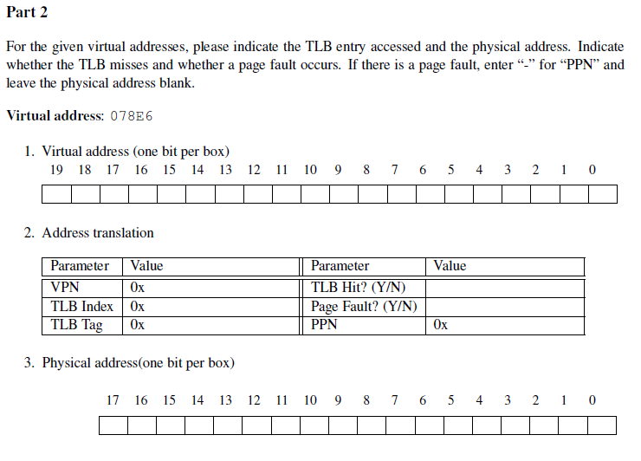

Slide 6
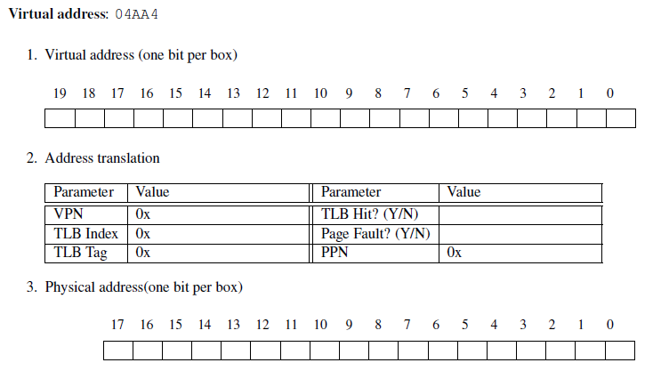

Slide 7
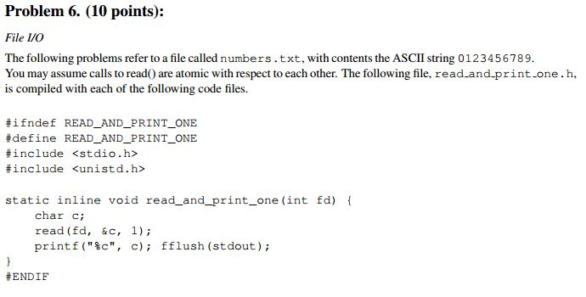
I/O Redirection
Final Exam Spring 2011

Slide 8
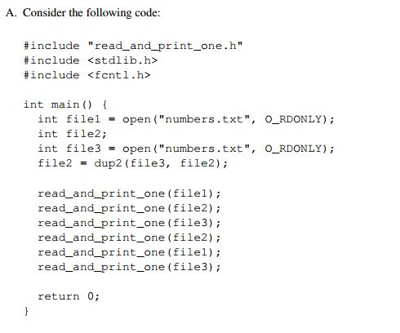
A. List all outputs of the following code.

Slide 9
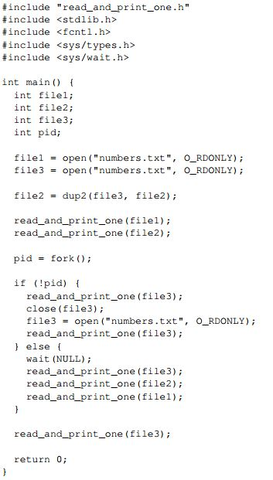
B. List all outputs of the following code.

Slide 10
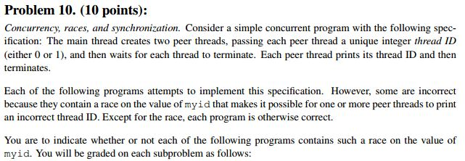
Threading
Final Exam Fall 2012

Slide 11
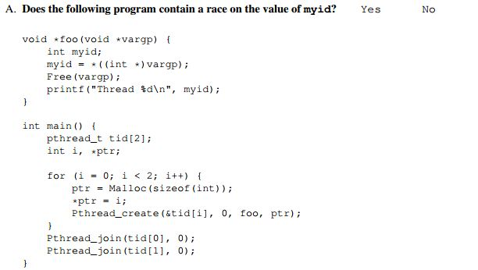

Slide 12
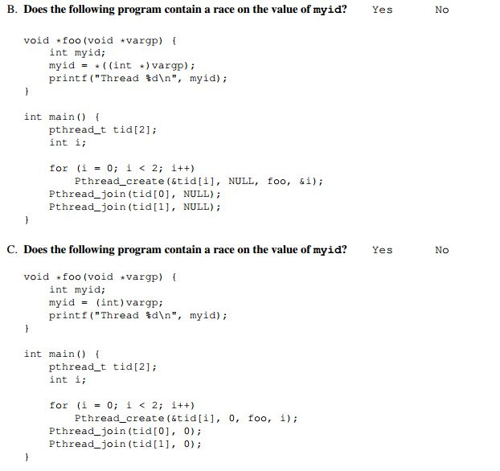

Slide 13
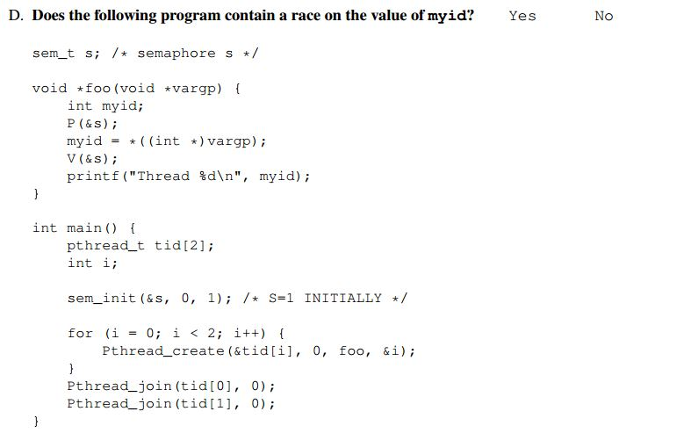

Slide 14
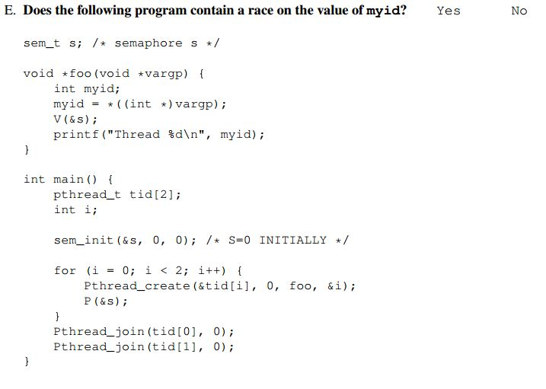

Slide 15
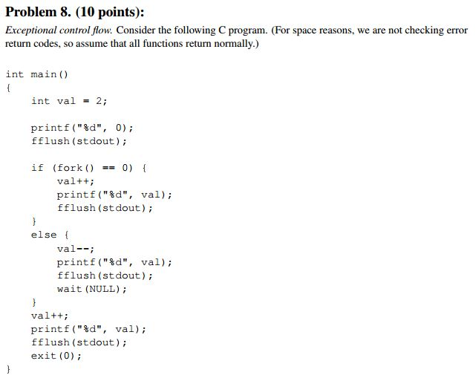
Processes and Signals
Final Exam Fall 2012

Slide 16
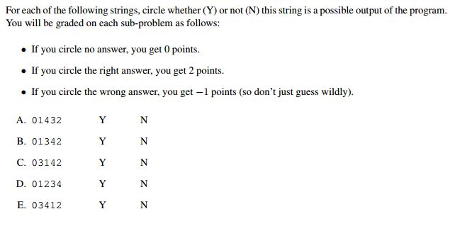

Slide 17
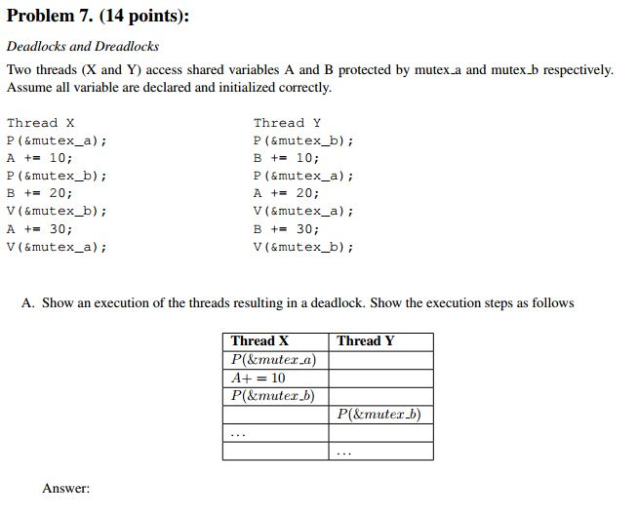
Deadlock
Final Exam Spring 2011

Slide 18
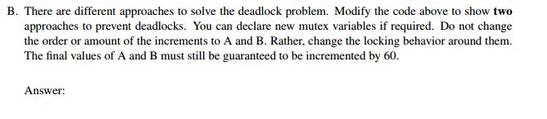

Slide 19
Questions?

